Slide 1
Greedy Algorithms
Activity Selection Problem

Slide 2
Activity Selection Problem
Suppose S = {a₁, a₂, ..., a_{n}} of n proposed activities that wish to use a resource.
Each activity a_{i} has a start time s_{i} and a finish time f_{i}, where 0 ≤ s_{i} < f_{i} < ∞.
If selected, activity a_{i} take place during the half-open time interval [s_{i}, f_{i}).
Activities a_{i} and a_{j} are compatible
if intervals [s_{i}, f_{i}) and [s_{j}, f_{j}) do not overlap
(i.e., a_{i} and a_{j} are compatible if s_{i} ≥ f_{j} or s_{j} ≥ f_{i}).

Slide 3
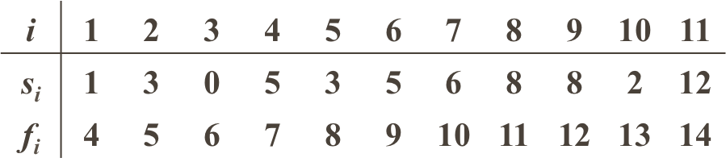
The activity-selection problem is to select a maximum-size subset of mutually compatible activities.
Example:
Some mutually compatible activities:
{a₃ , a₉ , a₁₁} --- not the largest
{a₁ , a₄ , a₈ , a₁₁}
{ a₂, a₄ , a₉ , a₁₁}

Slide 4
We shall solve this problem in several steps. We start by formulating a dynamic programming solution to this program in which we combine optimal solutions to two subproblems to form an optimal solution to the original problem.
We shall then observe that we need only consider one choice – the greedy choice – and that when we make the greedy choice, one of the subproblems is guaranteed to be empty, so that only one nonempty subproblem remains.

Slide 5
Greedy choice property
Repeated sub-problems and optimal substructure properties hold in activity selection problem
Greed choice property:
a sequence of locally optimal (greedy) choices
⇒ an optimal solution
Some problems (such as activity selection) has greedy choice property, we can use a greedy algorithm for those problems.
We may use dynamic programming (or memoize) approch for them too, but it will be cumbersome.
If a problem does not have greedy choice property, we may not use a greedy algorithm for that problem, but we can still use a dynamic programming approach.
Assume (without loss of generality) f₁ ≤ f₂ ≤ … ≤ f_{n}
– If not, sort activities according to their finish times in non decreasing order

Slide 6
Optimal substructure of the activity-selection problem
S_{ij}={a_{k}∈S : f_{i} ≤ s_{k} < f_{k} ≤ s_{j}},
is the subset of activities in S that can start after activity a_{i} finishes and finish before activity a_{j} starts.
Assume f₀ ≤ f₁ ≤ f₂ ≤ … ≤ f_{n} ≤ f_{n+1}
(the activities are sorted in monotonically increasing order of finish time)
f₀= 0 and s_{n+1} = ∞.
S = S_{0,n+1}, and 0 ≤ i, j ≤ n+1.
A_{ij} = A_{ik} ∪{a_{k}} ∪A_{kj}

Slide 7
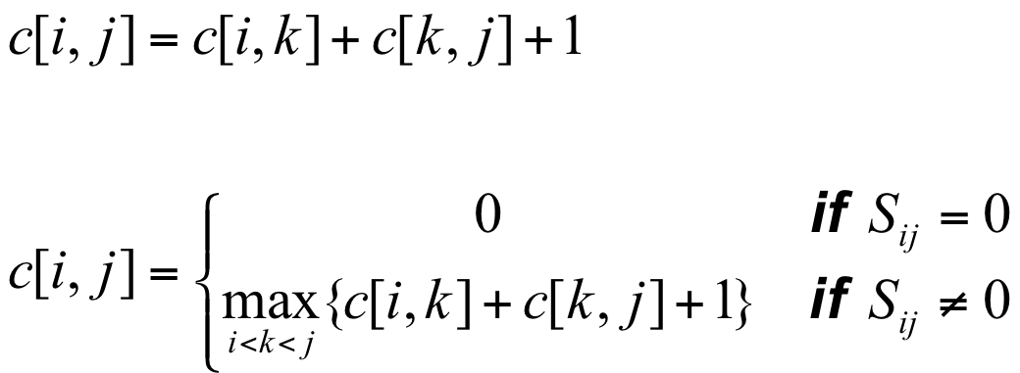
A recursive solution
c[i, j]: The number of activities in a maximum-size subset of mutually compatible activities in S_{ij}

Slide 8
Converting a dynamic-programming solution to a greedy solution
Theorem 16.1
Consider any nonempty subproblem S_{ij}, and let a_{m} be the activity in S_{ij} with the earliest finish time:
f_{m} = min { f_{k} : a_{k} ∈ S_{ij}}.
then
1. Activity a_{m} is used in some maximum-size subset of mutually compatible activities of S_{ij}.
2. The subproblem S_{im} is empty, so that choosing a_{m} leaves the subproblem S_{mj} as the only one that may be nonempty.

Slide 9
This theorem(16.1) is great
# of subproblems in optimal solution
2 (before theorem)→ 1 (after theorem)
Just need to consider S_{mj}
# of choices to consider
j − i −1 (before theorem) → 1 (after theorem)
Just choose a_{m}

Slide 10
Greedy algorithm - recursive
RECURSIVE-ACTIVITY-SELECTOR(s, f, i, j)
1 m ← i +1
2 while m < j and s_{m} < f_{i} Find the first activity in S_{ij}
3 do m ← m + 1
4 if m < j
5 then return {a_{m}}∪RAS(s, f, m, j)
6 else return 0
Complexity: Θ (n)

Slide 11
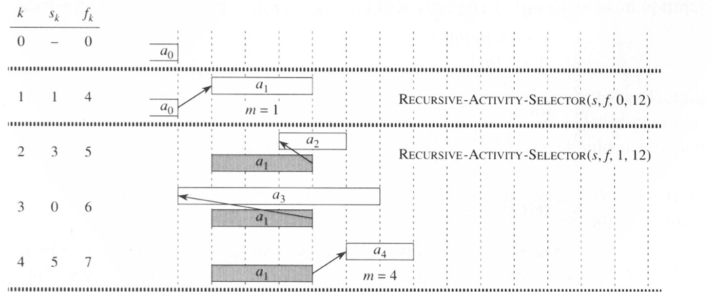
The operation of RECURSIVE-ACTIVITY-SELECTOR on the 11 activities given earlier

Slide 12
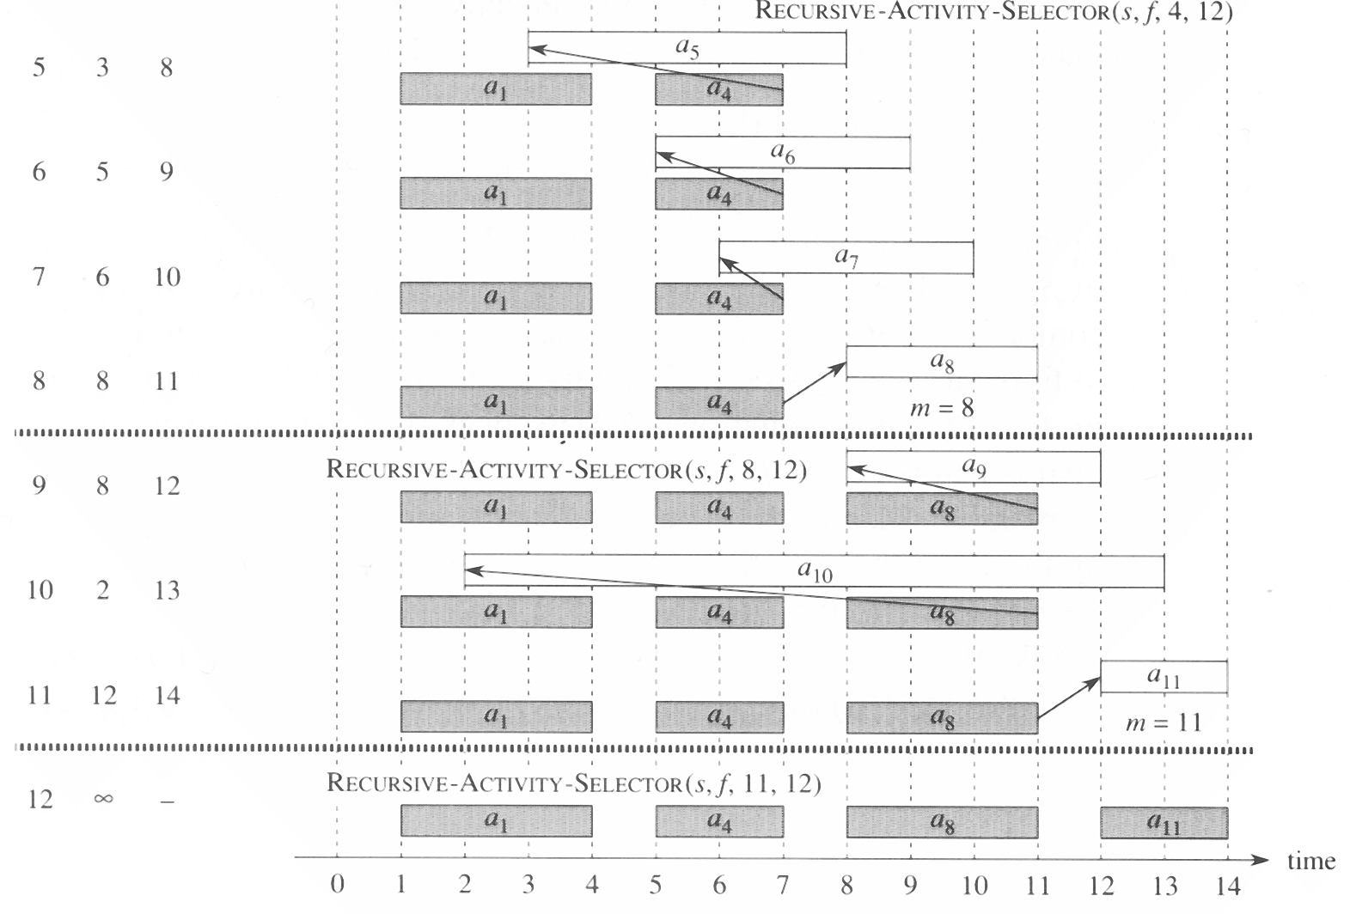

Slide 13
Greedy algorithm - iterative
GREEDY-ACTIVITY-SELECTOR(s, f)
1 n ← length[s]
2 a ← {a₁}
3 i ← 1
4 for m ← 2 to n
5 do if s_{m} ≥ f_{i}
6 then A ← A ∪ {a_{m}}
7 i ← m
8 return A
Complexity: Θ (n)

Slide 14
Elements of the greedy strategy
1. Determine the optimal substructure of the problem.
2. Develop a recursive solution.
3. Prove that at any stage of the recursion, one of the optimal choices is the greedy choice. Thus, it is always safe to make the greedy choice.
4. Show that all but one of the subproblems induced by having make the greedy choice are empty.

Slide 15
Develop a recursive algorithm that implements the greedy strategy.
6. Convert the recursive algorithm to an iterative algorithm.
Alternatively, we could have fashioned our optimal substructure with a greedy choice in mind.

Slide 16
Designing a greedy algorithm
1. Cast the optimization problem as one in which we make a choice and are left with one subproblem to solve.
2. Prove that there is always an optimal solution to the original problem that makes the greedy choice, so that the greedy choice is always safe.
3. Demonstrate that, having made the greedy choice , what remains is a subproblem with the property that if we combine an optimal solution to the subproblem with the greedy choice we have made, we arrive at an optimal solution to the original problem.

Slide 17
No general way to tell if a greedy algorithm is optimal, but two key ingredients are:
Greedy-choice property: A global optimal solution can be achieved by making a local optimal (optimal) choice.
Optimal substructure: An optimal solution to the problem within its optimal solution to subproblem.

